Slide 1
Deep Learning
Dr. Rakhee Chhibber

Slide 2
Agenda
Introduction to Deep learning
Components of Neural Networks
Hyper-Parameters
Deep Learning Architectures / Models

Slide 3
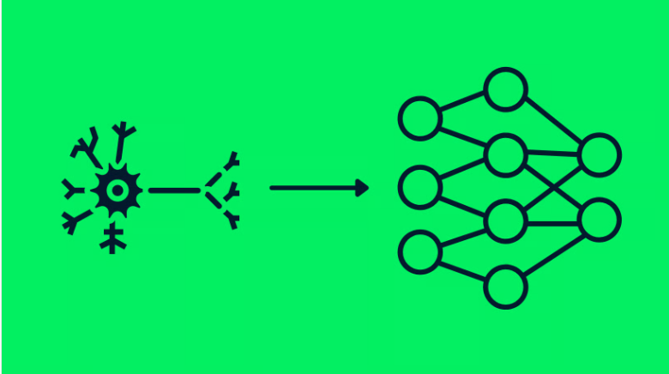
Introduction to Deep Learning
Deep learning is a type of machine learning that teaches computers to perform tasks by learning from examples, much like humans do. Imagine teaching a computer to recognize cats: instead of telling it to look for whiskers, ears, and a tail, you show it thousands of pictures of cats. The computer finds the common patterns all by itself and learns how to identify a cat. This is the essence of deep learning.
Deep learning is inspired by the human brain's structure where billions of neurons communicate through signals. These networks consist of layers of interconnected nodes that process information. The more layers, the "deeper" the network, allowing it to learn more complex features and perform more sophisticated tasks.

Slide 4
Components of Neural Networks
Neural Networks
Neurons
Layers in Neural Networks
Weights and Biases
Forward Propagation
Activation Functions
Loss Functions
Backpropagation
Learning Rate

Slide 5
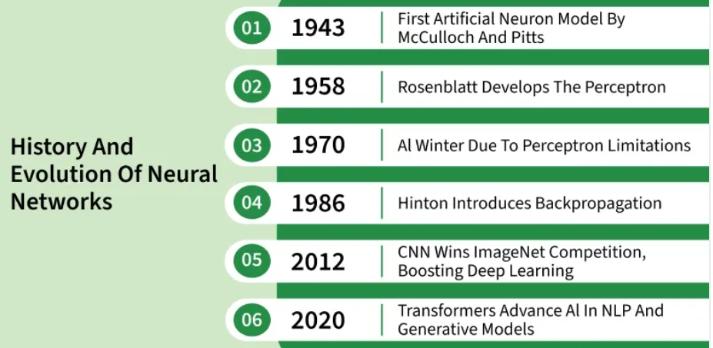
Neuron Networks
Neural networks are machine learning models that mimic the complex functions of the human brain. These models consist of interconnected nodes or neurons that process data, learn patterns and enable tasks such as pattern recognition and decision-making.

Slide 6
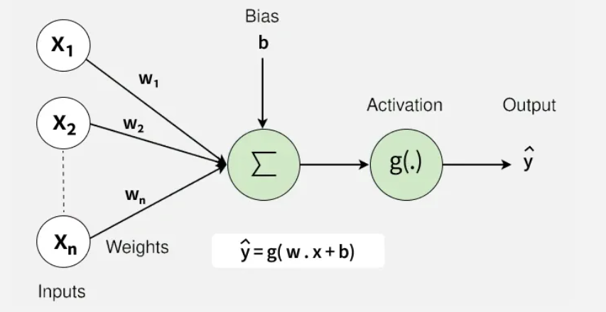
Components of Neural Network
Neurons: The basic units that receive inputs, each neuron is governed by a threshold and an activation function.
Connections: Links between neurons that carry information, regulated by weights and biases.
Weights and Biases: These parameters determine the strength and influence of connections.
Propagation Functions: Mechanisms that help process and transfer data across layers of neurons.
Learning Rule: The method that adjusts weights and biases over time to improve accuracy.

Slide 7
Process of Neural Network
a structured, three-stage process:
Input Computation: Data is fed into the network.
Output Generation: Based on the current parameters, the network generates an output.
Iterative Refinement: The network refines its output by adjusting weights and biases, gradually improving its performance on diverse tasks.

Slide 8
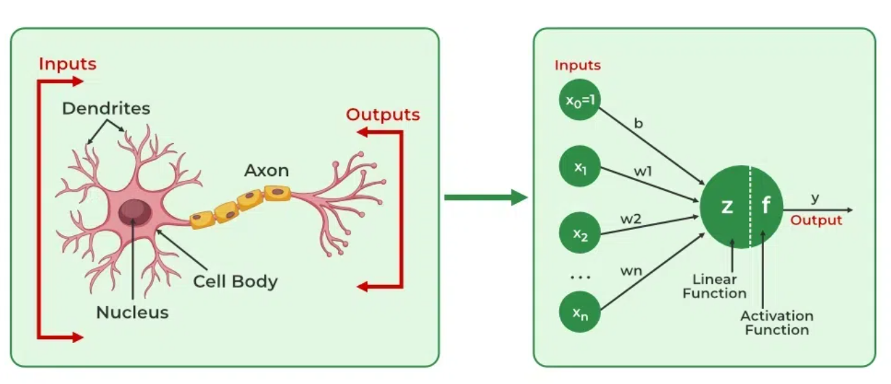
Neural Networks in adaptive Learning Environment
The neural network is exposed to a simulated scenario or dataset.
Parameters such as weights and biases are updated in response to new data or conditions.
With each adjustment, the network’s response evolves allowing it to adapt effectively to different tasks or environments.

Slide 9
Importance of Neural Networks
Identify Complex Patterns: Recognize intricate structures and relationships in data; adapt to dynamic and changing environments.
Learn from Data: Handle vast datasets efficiently; improve performance with experience and retraining.
Drive Key Technologies: Power natural language processing (NLP); enable self-driving vehicles; support automated decision-making systems.
Boost Efficiency: Streamline workflows and processes; enhance productivity across industries.
Backbone of AI: Serve as the core driver of artificial intelligence progress; continue shaping the future of technology and innovation.

Slide 10
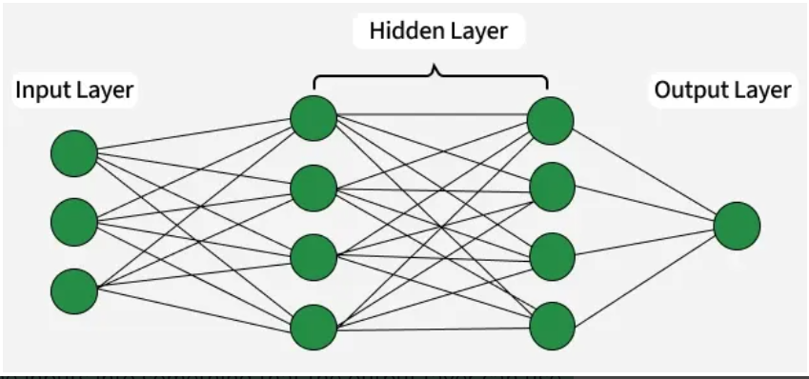
Layers in Neural Network Architecture
Input Layer: This is where the network receives its input data. Each input neuron in the layer corresponds to a feature in the input data.
Hidden Layers: These layers perform most of the computational heavy lifting. A neural network can have one or multiple hidden layers. Each layer consists of units (neurons) that transform the inputs into something that the output layer can use.
Output Layer: The final layer produces the output of the model. The format of these outputs varies depending on the specific task like classification, regression.

Slide 11
Working of Neural Networks – 3 steps
1. Forward Propogation
Linear Transformation
Activation
2. Backpropagation
Loss Calculation
Gradient Calculation
Weight Update
3. Iteration

Slide 12
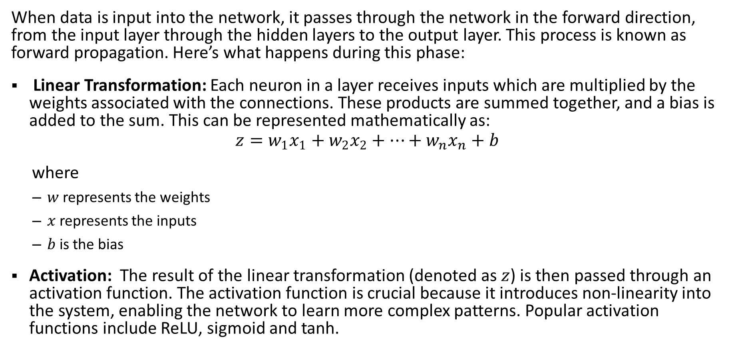
1. Forward Propagation
When data is input into the network, it passes through the network in the forward direction, from the input layer through the hidden layers to the output layer. This process is known as forward propagation. Here’s what happens during this phase:
Linear Transformation: Each neuron in a layer receives inputs which are multiplied by the weights associated with the connections. These products are summed together, and a bias is added to the sum. This can be represented mathematically as:
$$z=w_{1}x_{1}+w_{2}x_{2}+…+w_{n}x_{n}+b$$
where
$w$ represents the weights
$x$ represents the inputs
$b$ is the bias
Activation: The result of the linear transformation (denoted as $z$) is then passed through an activation function. The activation function is crucial because it introduces non-linearity into the system, enabling the network to learn more complex patterns. Popular activation functions include ReLU, sigmoid and tanh.

Slide 13
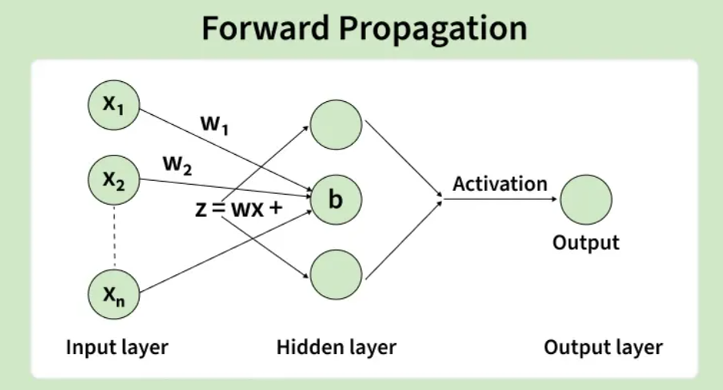
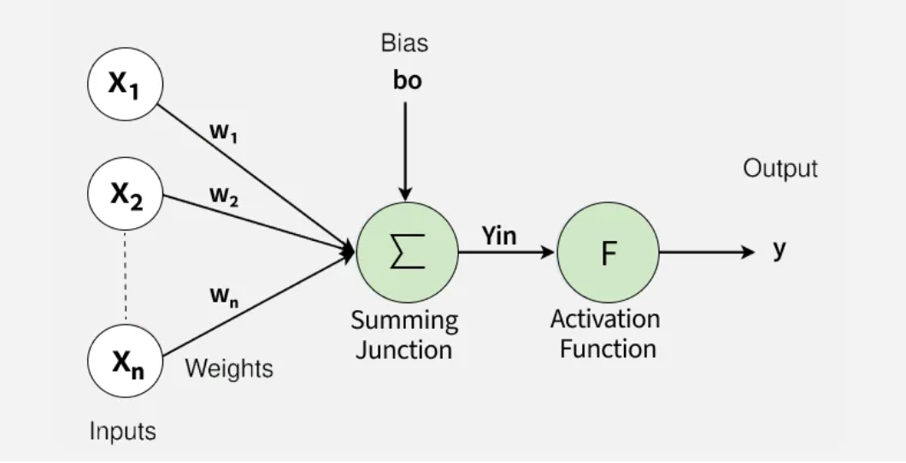

Slide 14
2. Backpropagation
After forward propagation, the network evaluates its performance using a loss function which measures the difference between the actual output and the predicted output. The goal of training is to minimize this loss. This is where backpropagation comes into play:
Loss Calculation: The network calculates the loss which provides a measure of error in the predictions which can vary like MSE(mean squared error) for regression tasks or cross-entropy loss for classification.
Gradient Calculation: The network computes the gradients of the loss function with respect to each weight and bias in the network. This involves applying the chain rule of calculus to find out how much each part of the output error can be attributed to each weight and bias.
Weight Update: Once the gradients are calculated, the weights and biases are updated using an optimization algorithm like stochastic gradient descent (SGD). The weights are adjusted in the opposite direction of the gradient to minimize the loss. The size of the step taken in each update is determined by the learning rate.

Slide 15
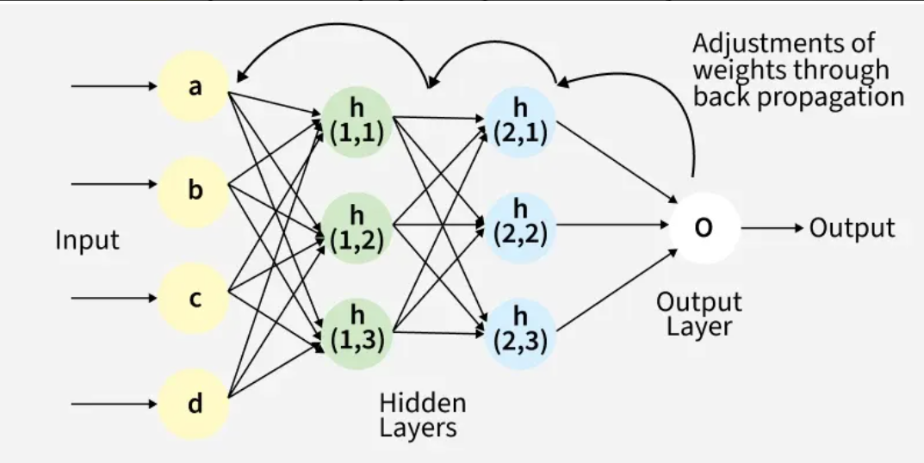

Slide 16
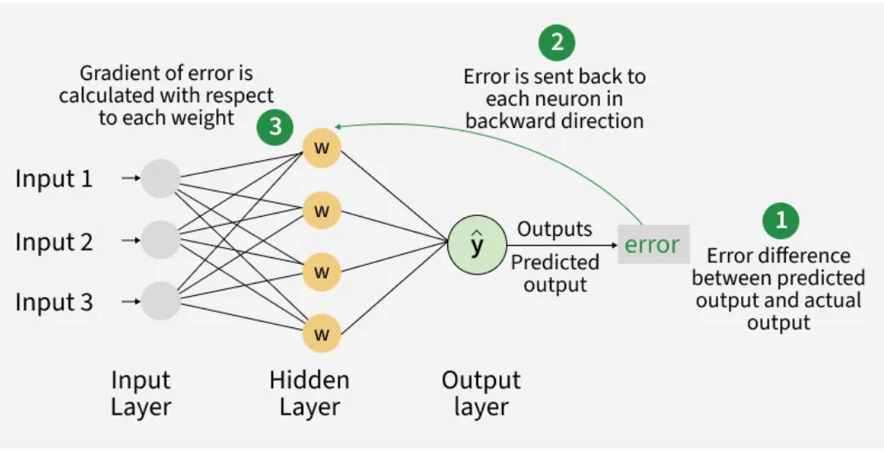

Slide 17
3. Iteration
This process of forward propagation, loss calculation, backpropagation and weight update is repeated for many iterations over the dataset to reduce the loss and more accurate predictions.

Slide 18
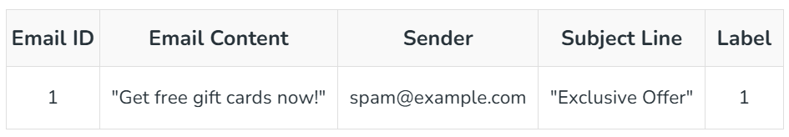
Example of Email Classification
To classify this email, we will create a feature vector based on the analysis of keywords such as "free" "win" and "offer"
The feature vector of the record can be presented as:
"free": Present (1)
"win": Absent (0)
"offer": Present (1)

Slide 19
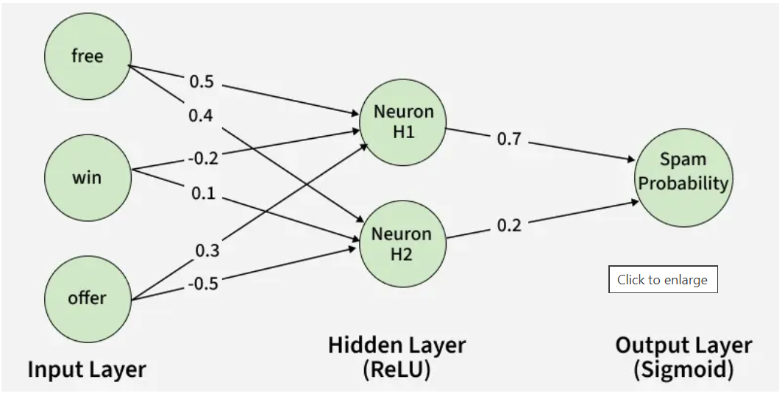

Slide 20
How Neurons Process Data in a Neural Network
1. Input Layer: The input layer contains 3 nodes that indicates the presence of each keyword.
2. Hidden Layer: The input vector is passed through the hidden layer. Each neuron in the hidden layer performs two primary operations: a weighted sum followed by an activation function.
Weights:
Neuron H1: [0.5,−0.2,0.3]
Neuron H2: [0.4,0.1,−0.5]
Input Vector: [1,0,1]
Weighted Sum Calculation
For H1: (1×0.5)+(0×−0.2)+(1×0.3)=0.5+0+0.3=0.8
For H2: (1×0.4)+(0×0.1)+(1×−0.5)=0.4+0−0.5=−0.1
Activation Function
Here we will use ReLu activation function:
H1 Output: ReLU(0.8)= 0.8
H2 Output: ReLu(-0.1) = 0

Slide 21
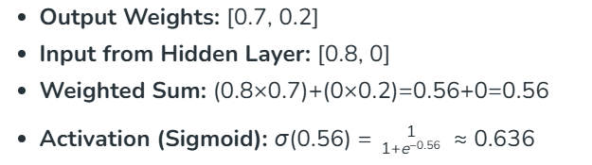
How Neurons Process Data in a Neural Network
3. Output Layer: The activated values from the hidden neurons are sent to the output neuron where they are again processed using a weighted sum and an activation function.
4. Final Classification: The output value of approximately 0.636 indicates the probability of the email being spam.
Since this value is greater than 0.5, the neural network classifies the email as spam (1).

Slide 22
Types of Neural Network

Slide 23
Perception - simplest form of a neural network
Singlelayer Perceptron: It has one layer and it applies weights, sums inputs and uses activation to produce output.
Multilayer Perceptron (MLP): It is a type of feedforward neural network with three or more layers, including an input layer, one or more hidden layers and an output layer. It uses nonlinear activation functions.
Feedforward Networks: It is a simple artificial neural network architecture in which data moves from input to output in a single direction.
Convolutional Neural Network (CNN): It is designed for image processing. It uses convolutional layers to automatically learn features from input images, enabling effective image recognition and classification.
Recurrent Neural Network (RNN): Handles sequential data using feedback loops to retain context over time.
Long Short-Term Memory (LSTM): A type of RNN with memory cells and gates to handle long-term dependencies and avoid vanishing gradients.

Slide 24
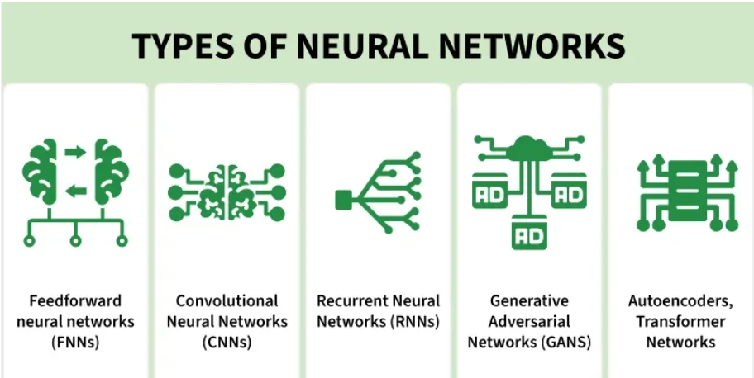
Deep Learning Architectures / Models

Slide 25
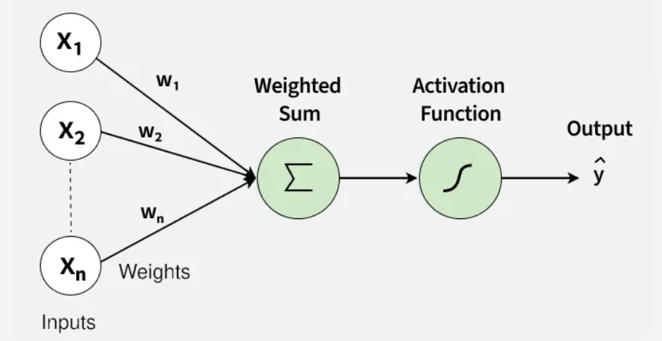
Perception
A Perceptron is the simplest form of a neural network that makes decisions by combining inputs with weights and applying an activation function. It is mainly used for binary classification problems. It forms the basic building block of many deep learning models.
Takes multiple inputs and assigns weights
Computes a weighted sum and applies a threshold
Outputs either 0 or 1 (binary outcome)
Forms the foundation of larger neural networks.

Slide 26
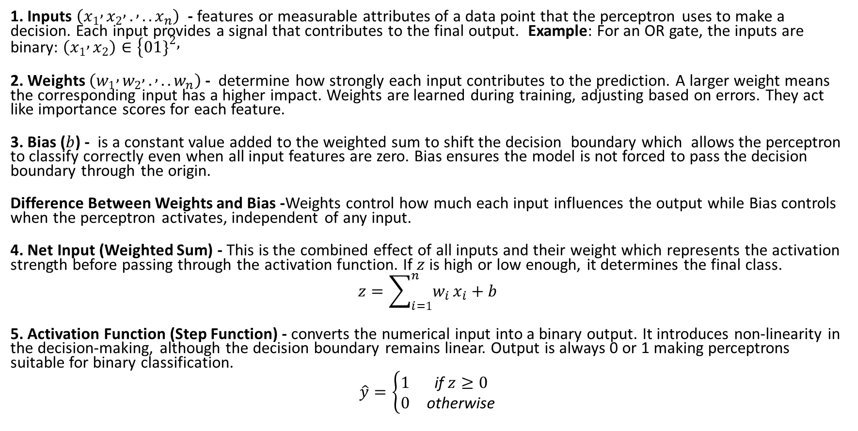
Steps of perception
1. Inputs $\left(x_{1} , x_{2} , . , ..x_{n}\right)$ - features or measurable attributes of a data point that the perceptron uses to make a decision. Each input provides a signal that contributes to the final output. Example: For an OR gate, the inputs are binary: $\left(x_{1} , x_{2}\right)∈\{01{\left.\}\right.}^{2},$
2. Weights $\left(w_{1} , w_{2} , . , ..w_{n}\right)$ - determine how strongly each input contributes to the prediction. A larger weight means the corresponding input has a higher impact. Weights are learned during training, adjusting based on errors. They act like importance scores for each feature.
3. Bias ($b$) - is a constant value added to the weighted sum to shift the decision boundary which allows the perceptron to classify correctly even when all input features are zero. Bias ensures the model is not forced to pass the decision boundary through the origin.
Difference Between Weights and Bias -Weights control how much each input influences the output while Bias controls when the perceptron activates, independent of any input.
4. Net Input (Weighted Sum) - This is the combined effect of all inputs and their weight which represents the activation strength before passing through the activation function. If $z$ is high or low enough, it determines the final class.
$$z=\sum_{i=1}^{n}{w_{i}}x_{i}+b$$
5. Activation Function (Step Function) - converts the numerical input into a binary output. It introduces non-linearity in the decision-making, although the decision boundary remains linear. Output is always 0 or 1 making perceptrons suitable for binary classification.
$$\hat{y}=\left\{\begin{matrix}1 & \text{if} z≥0 \\ 0 & \text{otherwise}\end{matrix}\right.$$

Slide 27
Example of perception

Slide 28
import numpy as np
import matplotlib.pyplot as plt
X_or = np.array([
[0, 0],
[0, 1],
[1, 0],
[1, 1]
])
y_or = np.array([0, 1, 1, 1])
importing the Libraries

Slide 29
class Perceptron:
def __init__(self, learning_rate=0.1, epochs=20):
self.lr = learning_rate
self.epochs = epochs
self.weights = None
self.bias = None
self.errors_per_epoch = []
def predict(self, X):
linear_output = np.dot(X, self.weights) + self.bias
return np.where(linear_output >= 0, 1, 0)
def fit(self, X, y):
n_samples, n_features = X.shape
self.weights = np.zeros(n_features)
self.bias = 0.0
for _ in range(self.epochs):
errors = 0
for xi, target in zip(X, y):
linear_output = np.dot(xi, self.weights) + self.bias
y_pred = 1 if linear_output >= 0 else 0
update = self.lr * (target - y_pred)
self.weights += update * xi
self.bias += update
errors += int(update != 0)
self.errors_per_epoch.append(errors)
Step 2: Define the Perceptron Class

Slide 30
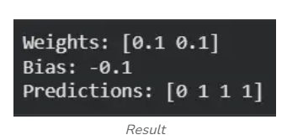
Step 3: Train the Perceptron on OR Data
p_or = Perceptron(learning_rate=0.1, epochs=20)
p_or.fit(X_or, y_or)
print("Weights:", p_or.weights)
print("Bias:", p_or.bias)
print("Predictions:", p_or.predict(X_or))

Slide 31
def plot_decision_boundary(X, y, model, title):
x_min, x_max = X[:, 0].min() - 1, X[:, 0].max() + 1
y_min, y_max = X[:, 1].min() - 1, X[:, 1].max() + 1
xx, yy = np.meshgrid(
np.linspace(x_min, x_max, 300),
np.linspace(y_min, y_max, 300)
)
grid = np.c_[xx.ravel(), yy.ravel()]
Z = model.predict(grid)
Z = Z.reshape(xx.shape)
plt.figure(figsize=(6, 5))
plt.contourf(xx, yy, Z, alpha=0.3, cmap="coolwarm")
for label in np.unique(y):
pts = X[y == label]
plt.scatter(pts[:, 0], pts[:, 1],
s=100, edgecolor='black',
label=f"Class {label}")
plt.title(title)
plt.xlabel("x1")
plt.ylabel("x2")
plt.legend()
plt.grid(True)
plt.show()
plot_decision_boundary(X_or, y_or, p_or, "Perceptron Decision Boundary (OR)")
Step 4: Decision Boundary Plot

Slide 32
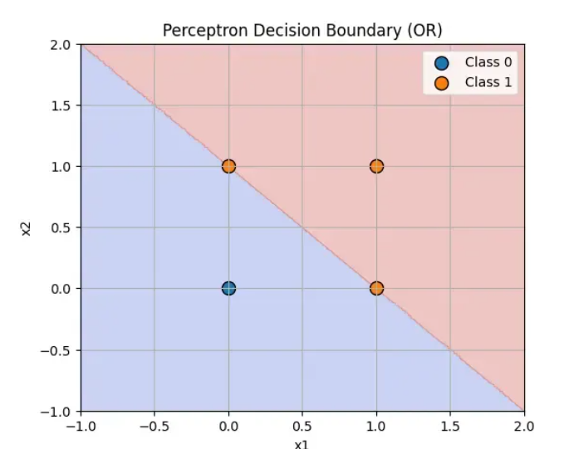

Slide 33
Step 5: Plot Misclassifications per Epoch
plt.figure(figsize=(6, 4))
plt.plot(p_or.errors_per_epoch, marker='o')
plt.title("Misclassifications per Epoch (OR)")
plt.xlabel("Epoch")
plt.ylabel("Errors")
plt.grid(True)
plt.show()

Slide 34
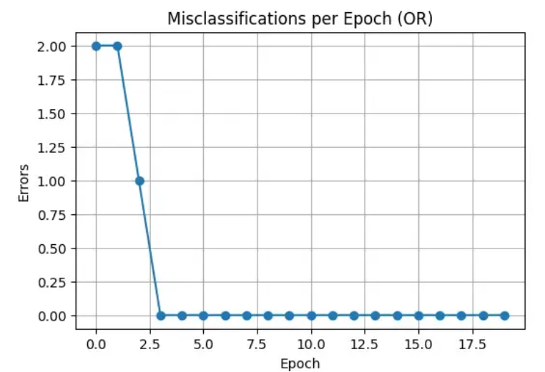

Slide 35
Single Layer Perception

Slide 36
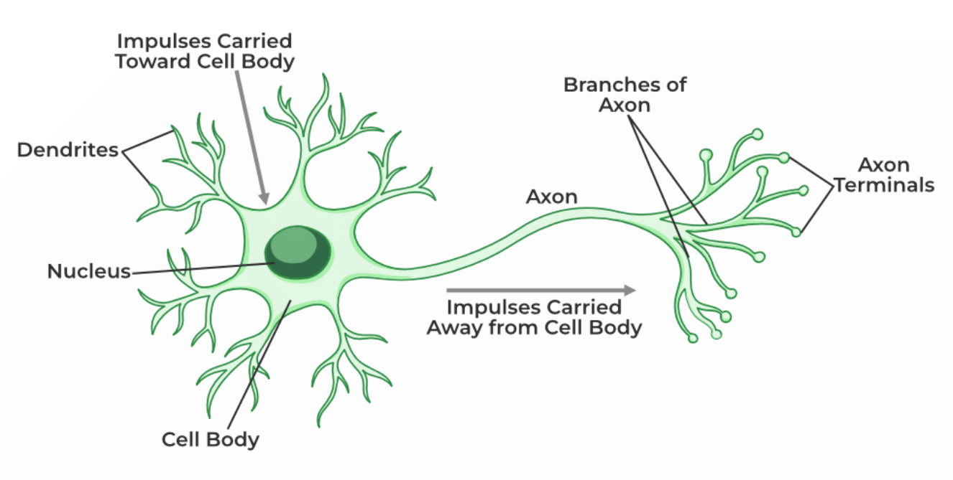
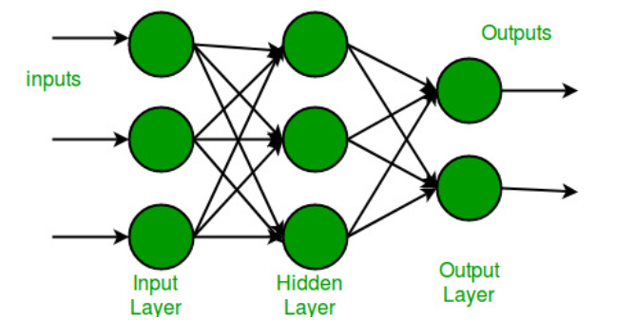
Single Layer Perceptron is inspired by biological neurons and their ability to process information. To understand the SLP we first need to break down the workings of a single artificial neuron which is the fundamental building block of neural networks. It is a simplified computational model that mimics the behavior of a biological neuron. It takes inputs, processes them and produces an output. Here's how it works step by step:
Receive signal from outside.
Process the signal and decide whether we need to send information or not.
Communicate the signal to the target cell, which can be another neuron or gland.

Slide 37
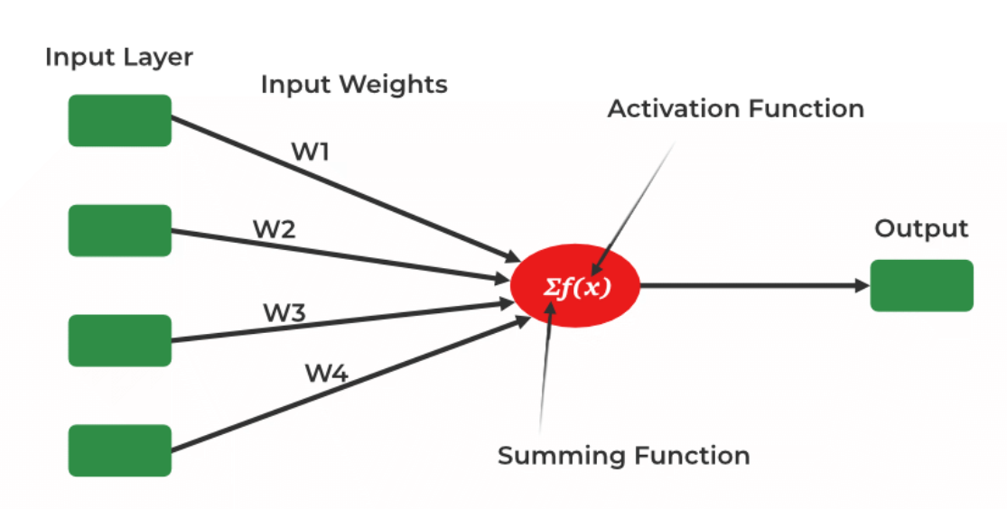
SLP
It is one of the oldest and first introduced neural networks. It was proposed by Frank Rosenblatt in 1958. Perceptron is also known as an artificial neural network. SLP is used to compute the logical gate like AND, OR and NOR which has binary input and binary output.
The main functionality of the perceptron is:-
Takes input from the input layer
Weight them up and sum it up.
Pass the sum to the nonlinear function to produce the output.

Slide 38
Step1: Import necessary libraries
import tensorflow as tf
from sklearn.datasets import make_classification
from sklearn.model_selection import train_test_split
from sklearn.preprocessing import StandardScaler

Slide 39
Step 2: Create and split synthetic dataset and Step 3: Standardize the Dataset
# split the dataset
X, y = make_classification(
n_samples=1000, n_features=2, n_informative=2, n_redundant=0,
n_repeated=0, n_classes=2, random_state=42
)
X_train, X_test, y_train, y_test = train_test_split(X, y, test_size=0.2, random_state=42)
# Satndardize the dataset
scaler = StandardScaler()
X_train = scaler.fit_transform(X_train)
X_test = scaler.transform(X_test)

Slide 40
Step 4: Building a neural network and Step 5: Compile the Model
# Building Model
model = tf.keras.Sequential([
tf.keras.layers.Dense(1, activation='sigmoid', input_shape=(2,)) ])
#model compilation
model.compile(optimizer='adam',
loss='binary_crossentropy',
metrics=['accuracy'])

Slide 41
Step 6: Train the Model & Step 7: Model Evaluation
# Train the model
history = model.fit(X_train, y_train,
epochs=50,
batch_size=16,
validation_split=0.1,
verbose=0)
# Model Evaluation
loss, accuracy = model.evaluate(X_test, y_test, verbose=0)
print(f"Test Accuracy: {accuracy:.2f}")

Slide 42
Multi-Layer Perceptron Learning in Tensorflow

Slide 43
Introduction
Multi-Layer Perceptron (MLP) consists of fully connected dense layers that transform input data from one dimension to another. It is called multi-layer because it contains an input layer, one or more hidden layers and an output layer. The purpose of an MLP is to model complex relationships between inputs and outputs.

Slide 44
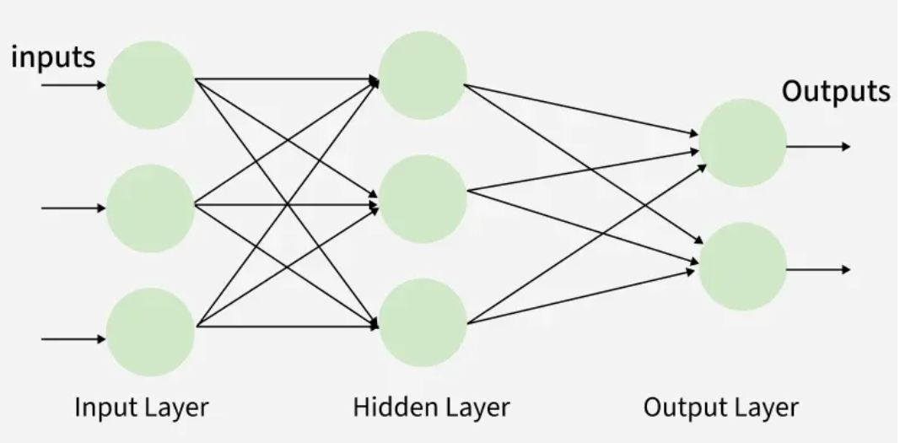
Components of Multi-Layer Perceptron (MLP)
Input Layer: Each neuron or node in this layer corresponds to an input feature. For instance, if you have three input features the input layer will have three neurons.
Hidden Layers: MLP can have any number of hidden layers with each layer containing any number of nodes. These layers process the information received from the input layer.
Output Layer: The output layer generates the final prediction or result. If there are multiple outputs, the output layer will have a corresponding number of neurons.
Every connection in the diagram is a representation of the fully connected nature of an MLP

Slide 45
Working of Multi-Layer Perceptron
Forward propagation,
Loss function,
Backpropagation and
Optimization.

Slide 46
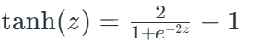
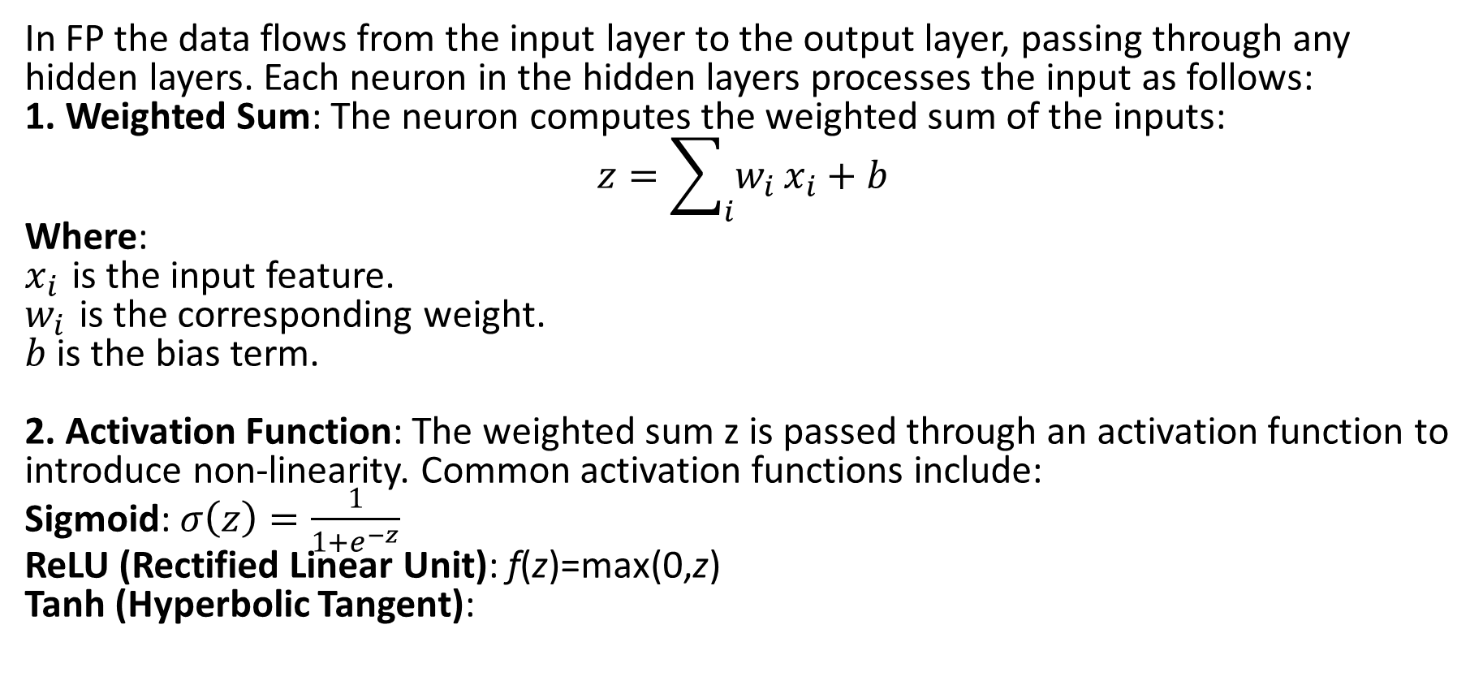
1. Forward Propagation
In FP the data flows from the input layer to the output layer, passing through any hidden layers. Each neuron in the hidden layers processes the input as follows:
1. Weighted Sum: The neuron computes the weighted sum of the inputs:
$$z=\sum_{i}{w_{i}}x_{i}+b$$
Where:
$x_{i}$​ is the input feature.
$w_{i}$​ is the corresponding weight.
$b$ is the bias term.
2. Activation Function: The weighted sum z is passed through an activation function to introduce non-linearity. Common activation functions include:
Sigmoid: $σ\left(z\right)=\frac{1}{1+e^{−z}}$
ReLU (Rectified Linear Unit): f(z)=max(0,z)
Tanh (Hyperbolic Tangent):

Slide 47
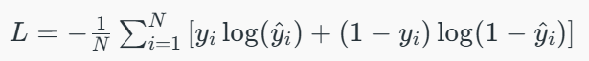
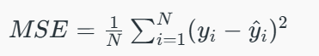
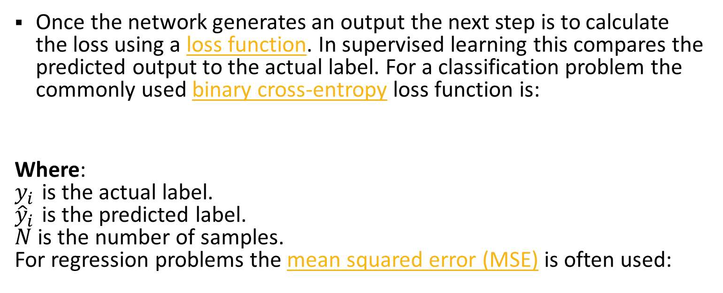
2. Loss Function
Once the network generates an output the next step is to calculate the loss using a loss function. In supervised learning this compares the predicted output to the actual label. For a classification problem the commonly used binary cross-entropy loss function is:
Where:
$y_{i}$ is the actual label.
${\hat{y}}_{i}$ is the predicted label.
$N$ is the number of samples.
For regression problems the mean squared error (MSE) is often used:

Slide 48
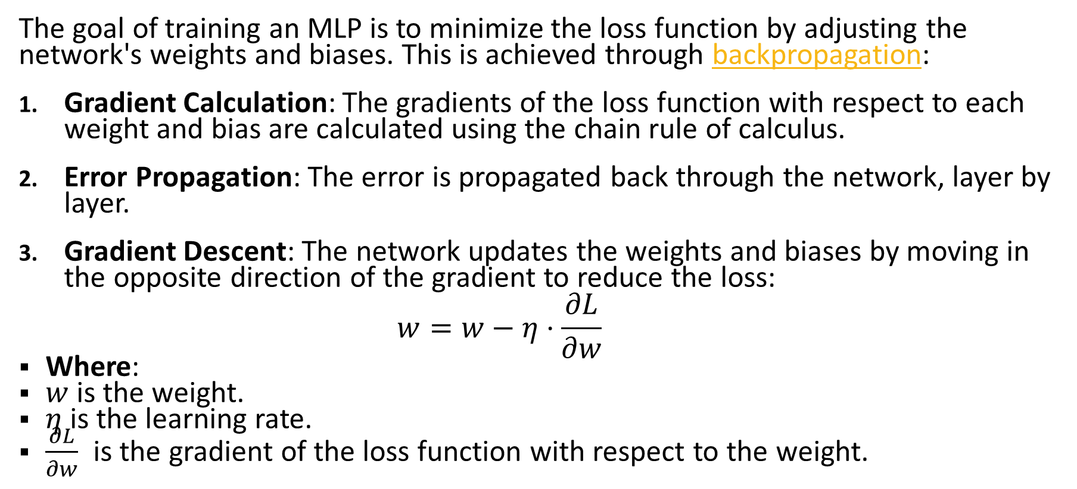
3. Backpropagation
The goal of training an MLP is to minimize the loss function by adjusting the network's weights and biases. This is achieved through backpropagation:
Gradient Calculation: The gradients of the loss function with respect to each weight and bias are calculated using the chain rule of calculus.
Error Propagation: The error is propagated back through the network, layer by layer.
Gradient Descent: The network updates the weights and biases by moving in the opposite direction of the gradient to reduce the loss:
$$w=w−η⋅\frac{∂L}{∂w}$$
Where:
$w$ is the weight.
$η$ is the learning rate.
$\frac{∂L}{∂w}\text{​}$ is the gradient of the loss function with respect to the weight.

Slide 49
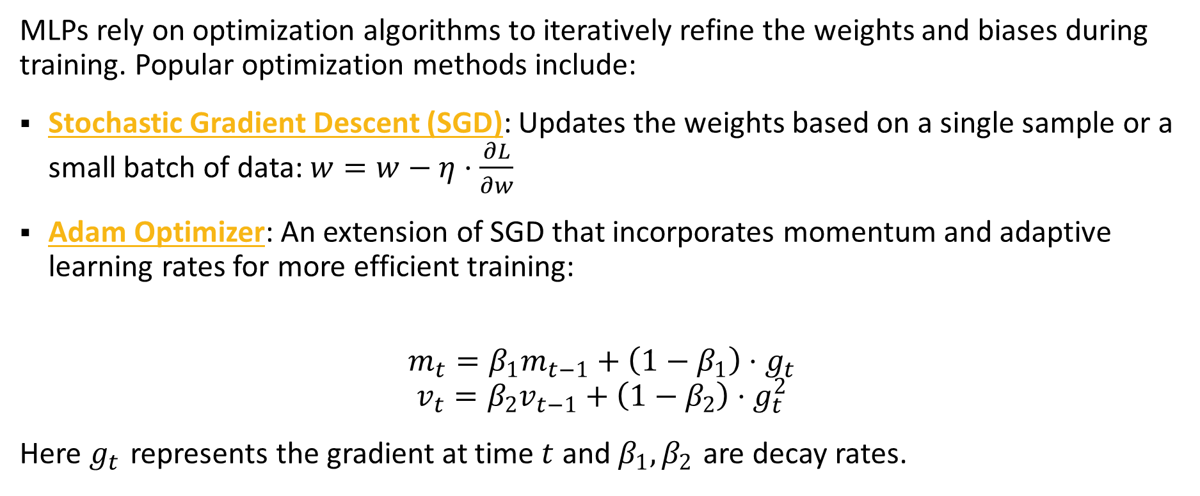
4. Optimization
MLPs rely on optimization algorithms to iteratively refine the weights and biases during training. Popular optimization methods include:
Stochastic Gradient Descent (SGD): Updates the weights based on a single sample or a small batch of data: $w=w−η⋅\frac{∂L}{∂w}$
Adam Optimizer: An extension of SGD that incorporates momentum and adaptive learning rates for more efficient training:
$$m_{t}=β_{1}m_{t−1}+\left(1−β_{1}\right)⋅g_{t}$$
$$v_{t}=β_{2}v_{t−1}+\left(1−β_{2}\right)⋅g_{t}^{2}$$
Here $g_{t}$​ represents the gradient at time $t$ and $β_{1},β_{2}$ are decay rates.

Slide 50
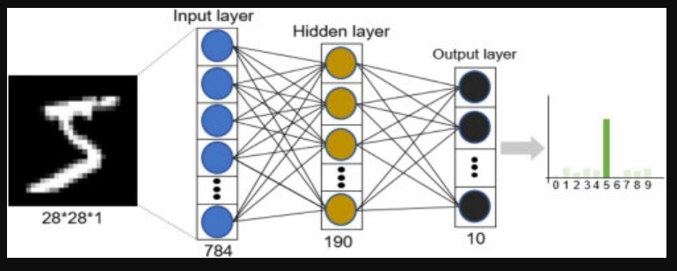
Practical Example: HandWritten MNIST with Fully Connected Neural Network (FCN)
https://colab.research.google.com/drive/17cNLVreLmBz9ZoF_i7WeuVclP5BQYTAS?authuser=7
https://colab.research.google.com/drive/19TCbNA-JoP6Q40XieD6SNs5KR5T9LcAT?authuser=7

Slide 51
Convolution Neural Network

Slide 52
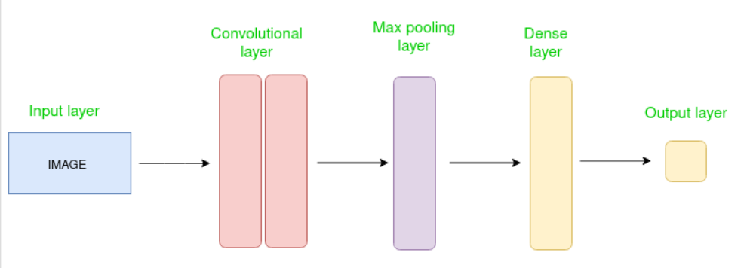
Introduction
CNN is an advanced version of artificial neural networks (ANNs), primarily designed to extract features from grid-like matrix datasets. This is particularly useful for visual datasets such as images or videos, where data patterns play a crucial role and widely used in computer vision applications due to their effectiveness in processing visual data.
It consist of multiple layers like the input layer, Convolutional layer, pooling layer, and fully connected layers.

Slide 53
How Convolutional Layers Works?
Input Layers: In CNN, Generally, the input will be an image or a sequence of images which holds the raw input of the image with width 32, height 32, and depth 3.
Convolutional Layers: This layer is used to extract the feature from the input dataset. It applies a set of learnable filters known as the kernels (smaller matrices usually 2x2, 3x3, or 5x5 shape) to the input images which slides over the input image data and computes the dot product between kernel weight and the corresponding input image patch and produce and output referred as feature maps
Activation Layer: this layer add nonlinearity to the network. it will apply an element-wise activation function to the output of the convolution layer. Some common activation functions are RELU: max(0, x), Tanh, Leaky RELU, etc.
Pooling layer: This layer is periodically inserted in the covnets and its main function is to reduce the size of volume which makes the computation fast reduces memory and also prevents overfitting. Two common types of pooling layers are max pooling and average pooling. If we use a max pool with 2 x 2 filters and stride 2, the resultant volume will be of dimension 16x16x12.
Flattening: The resulting feature maps are flattened into a one-dimensional vector after the convolution and pooling layers so they can be passed into a completely linked layer for categorization or regression.
Fully Connected Layers: It takes the input from the previous layer and computes the final classification or regression task.

Slide 54
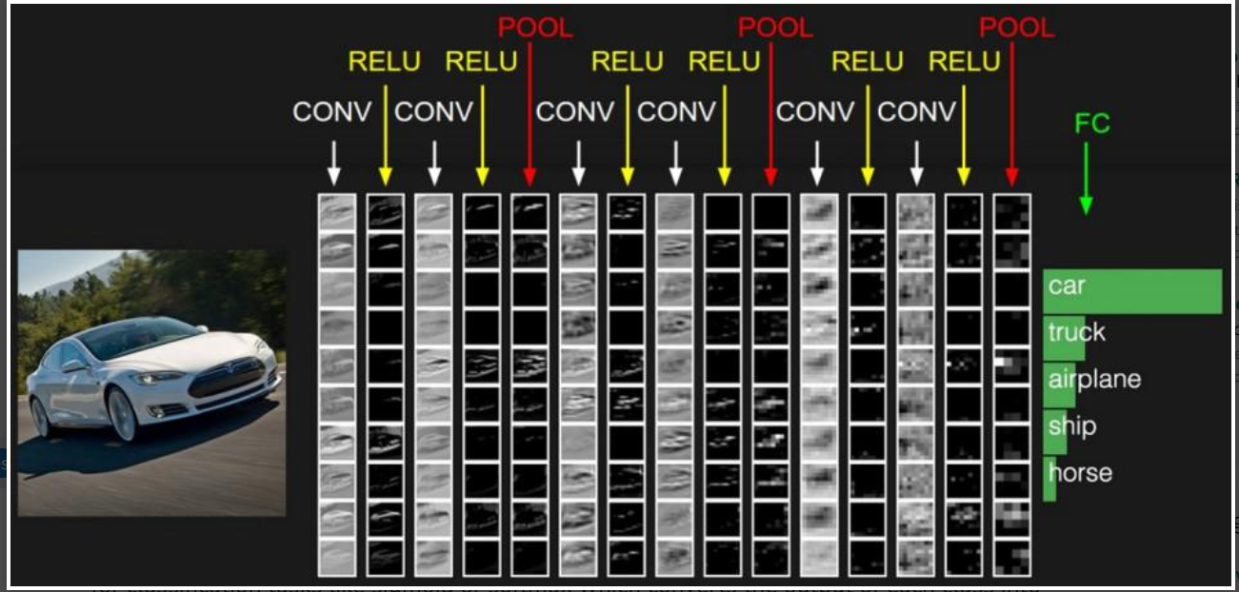

Slide 55

Example – Applying CNN to an Image https://colab.research.google.com/drive/1_Stcp42QU_89o9rewZyulEk0t2U7UWuF?authuser=7
import the necessary libraries
set the parameter
define the kernel
Load the image and plot it.
Reformat the image
Apply convolution layer operation and plot the output image.
Apply activation layer operation and plot the output image.
Apply pooling layer operation and plot the output image.

Slide 56
Recurrent Neural Networks (RNN)
https://colab.research.google.com/drive/1dPwuePS6wHi4h5soUhrVw7Ju5fuSJn4g?authuser=7

Slide 57
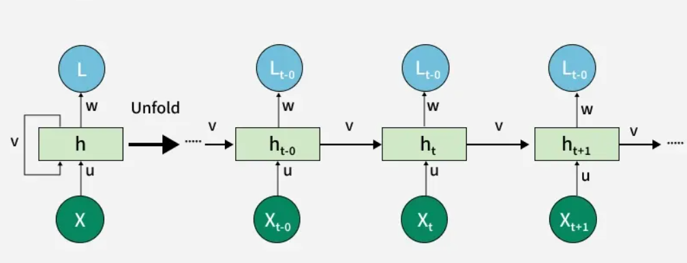
Introduction to RNN
Recurrent Neural Networks (RNNs) differ from regular neural networks in how they process information. While standard neural networks pass information in one direction i.e. from input to output, RNNs feed information back into the network at each step.

Slide 58
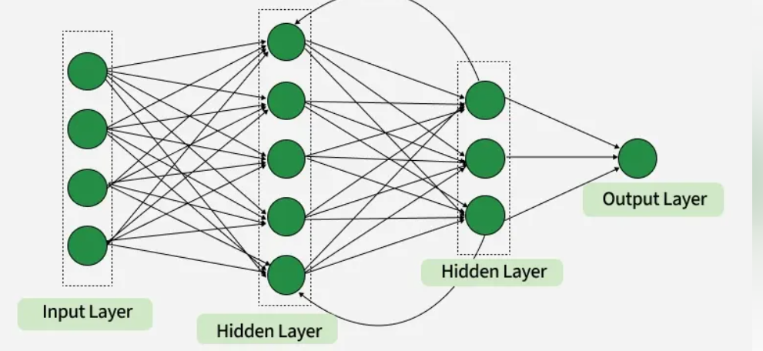

Slide 59
RNN Example
Imagine reading a sentence and you try to predict the next word, you don’t rely only on the current word but also remember the words that came before. RNNs work similarly by “remembering” past information and passing the output from one step as input to the next i.e it considers all the earlier words to choose the most likely next word. This memory of previous steps helps the network understand context and make better predictions.

Slide 60
Components of RNNs
Recurrent Neurons
RNN Unfolding

Slide 61
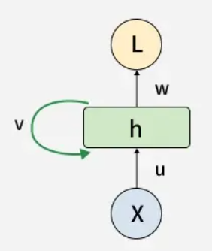
1. Recurrent Neurons
The fundamental processing unit in RNN is a Recurrent Unit. They hold a hidden state that maintains information about previous inputs in a sequence. Recurrent units can "remember" information from prior steps by feeding back their hidden state, allowing them to capture dependencies across time.

Slide 62
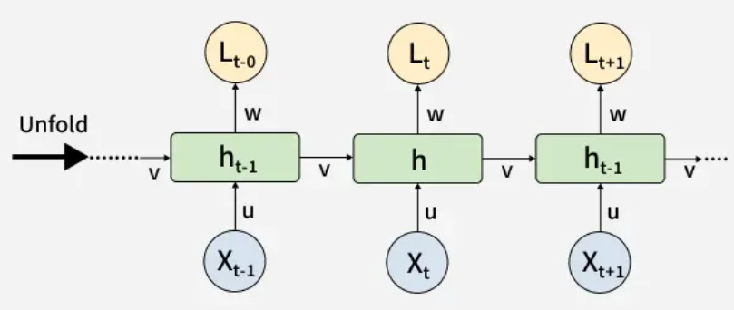
2. RNN Unfolding
It is the process of expanding the recurrent structure over time steps. During unfolding each step of the sequence is represented as a separate layer in a series illustrating how information flows across each time step.
This unrolling enables backpropagation through time (BPTT) a learning process where errors are propagated across time steps to adjust the network’s weights enhancing the RNN’s ability to learn dependencies within sequential data.

Slide 63
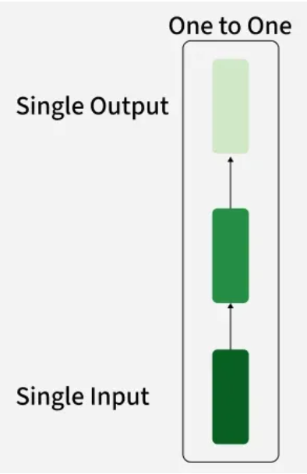
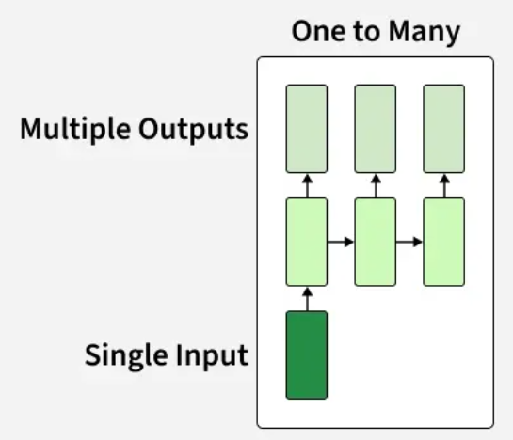
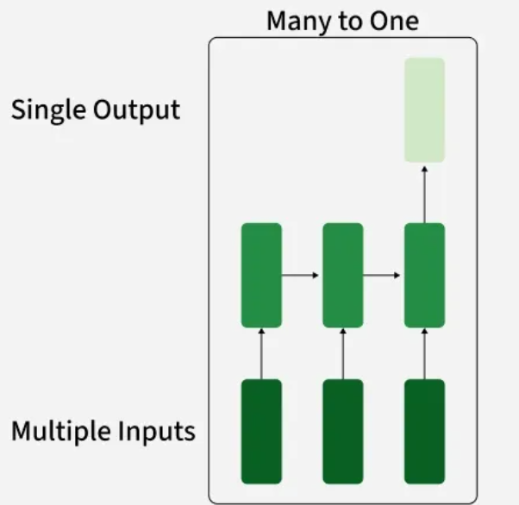
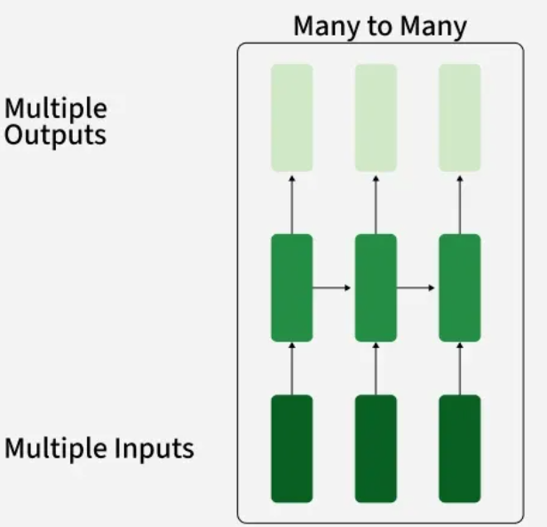
Types Of Recurrent Neural Networks

Slide 64
Variants of Recurrent Neural Networks (RNNs)
1. Vanilla RNN - This simplest form of RNN consists of a single hidden layer where weights are shared across time steps. These are suitable for learning short-term dependencies but are limited by the vanishing gradient problem, which hampers long-sequence learning.
2. Bidirectional RNNs - process inputs in both forward and backward directions, capturing both past and future context for each time step. This architecture is ideal for tasks where the entire sequence is available, such as named entity recognition and question answering.
3. Long Short-Term Memory Networks (LSTMs) – introduce a memory mechanism to overcome the vanishing gradient problem. Each LSTM cell has three gates:
Input Gate: Controls how much new information should be added to the cell state.
Forget Gate: Decides what past information should be discarded.
Output Gate: Regulates what information should be output at the current step. This selective memory enables LSTMs to handle long-term dependencies, making them ideal for tasks where earlier context is critical.
4. Gated Recurrent Units (GRUs) -Gated Recurrent Units (GRUs) simplify LSTMs by combining the input and forget gates into a single update gate and streamlining the output mechanism. This design is computationally efficient, often performing similarly to LSTMs and is useful in tasks where simplicity and faster training are beneficial.

Slide 65
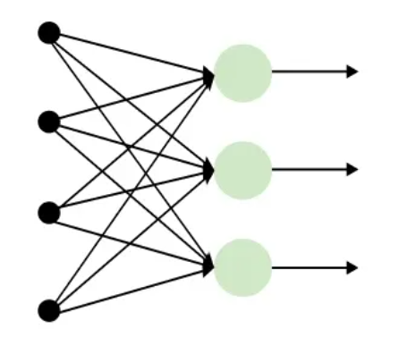
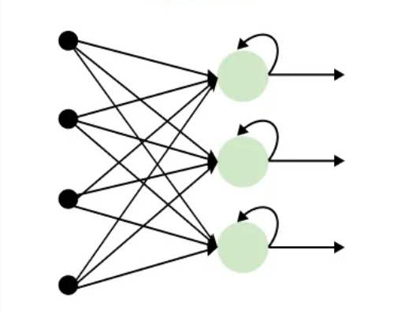
How RNN Differs from Feedforward Neural Networks?
Recurrent Neural Networks (RNNs) solve this by incorporating loops that allow information from previous steps to be fed back into the network. This feedback enables RNNs to remember prior inputs making them ideal for tasks where context is important.
Feedforward Neural Networks (FNNs) process data in one direction from input to output without retaining information from previous inputs. This makes them suitable for tasks with independent inputs like image classification. However FNNs struggle with sequential data since they lack memory.

Slide 66
Text Generator Using Recurrent Neural Networks (RNNs)
https://colab.research.google.com/drive/1dPwuePS6wHi4h5soUhrVw7Ju5fuSJn4g?authuser=7

Slide 67
Thank you

